Slide 1
Module Thirteen, Activity Two
Instruments

Slide 2
Get out a blank sheet of paper and a pencil.
For the following slides, use your instrument classification chart to identify the types of instruments shown in the pictures/videos.

Slide 3
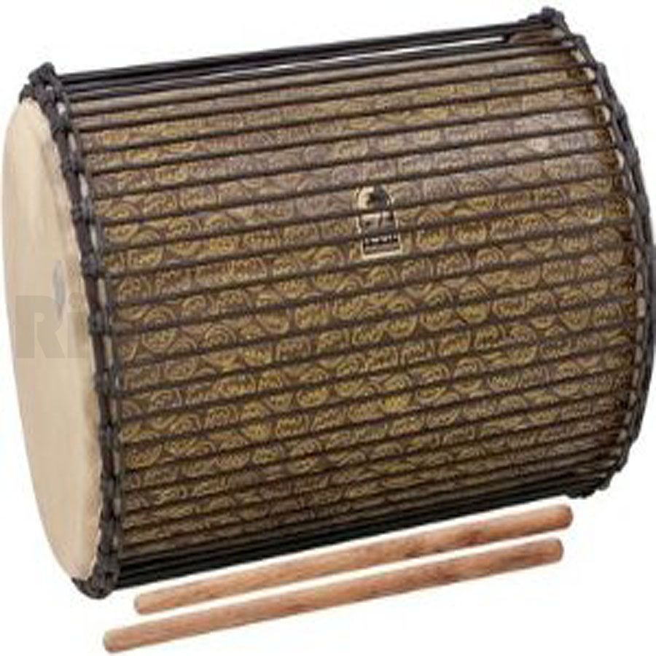
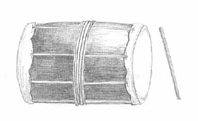
1. Djundjun

Slide 4
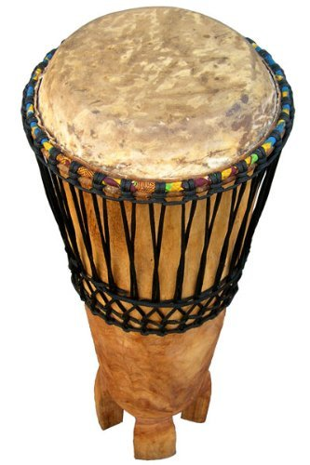
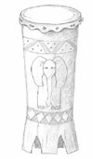
2. Ngoma

Slide 5
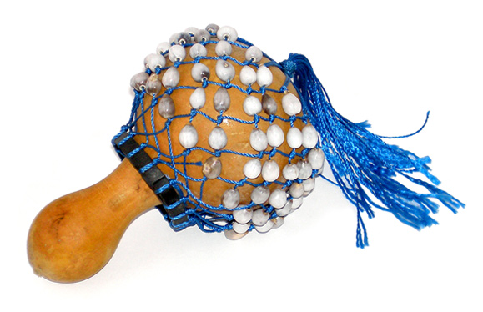
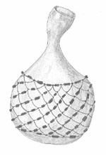
3. Axatse

Slide 6
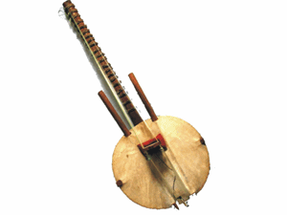
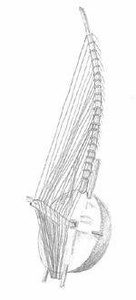
4. Kora

Slide 7
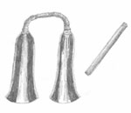
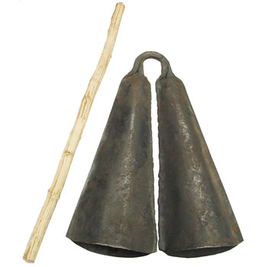
5. Agogo Bell

Slide 8
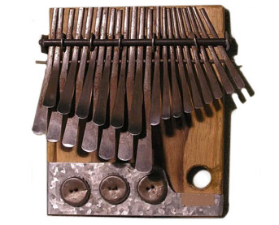
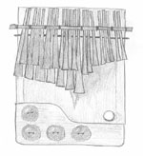
6. Mbira

Slide 9
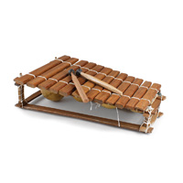
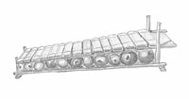
7. Balafon

Slide 10
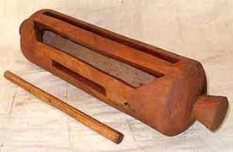
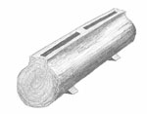
8. Log Slit Drum

Slide 11
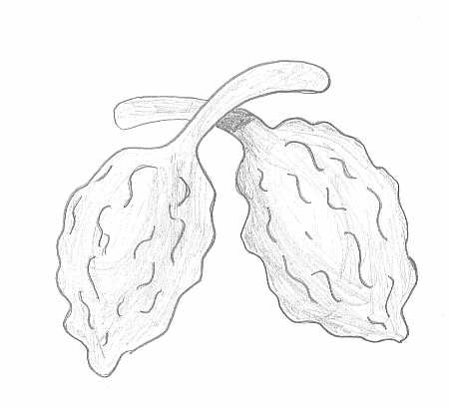
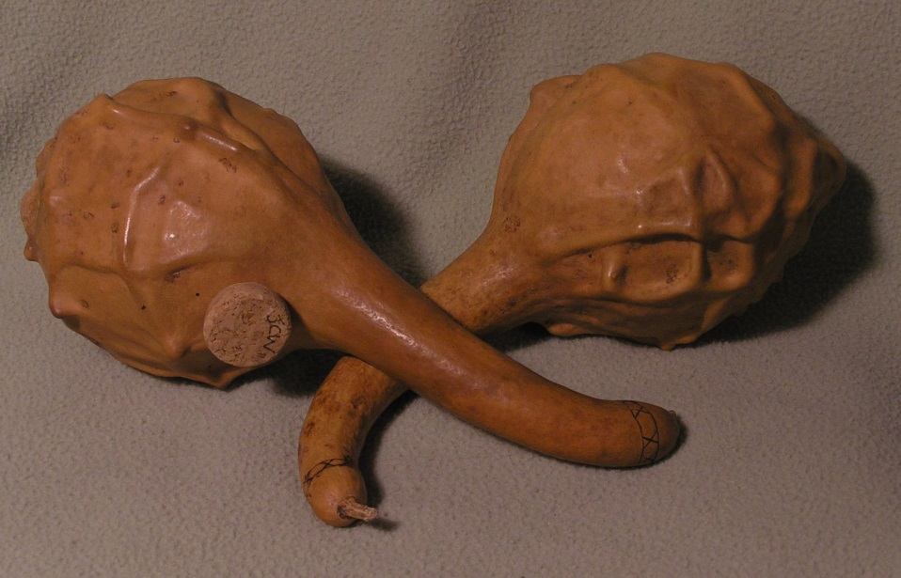
9. Hosho

Slide 12
Answers

Slide 13
1. Djundjun
Membranophone
It’s a drum with skin stretched over two sides. It is found in West Africa.

Slide 14
2. Ngoma
Membranophone
This drum has skin only on the top. It is found in East and Southern Africa.

Slide 15
3. Axatse
Idiophone
This is a shaken idiophone found in West Africa.

Slide 16
4. Kora
Chordophone
This is a stringed instrument that has been used for centuries to praise leaders and maintain oral history. It is found in West Africa.

Slide 17
5. Agogo Bell
Idiophone
This is a struck idiophone found in Central Africa, and is used to keep time for other musicians

Slide 18
6. Mbira
Lamellophone
This instrument is problematic in its classification because it contains so many different parts that contribute to its sound (the sound board, the bottle-cap buzzers, and the metal prongs that are plucked with the thumbs). In the form here, it is common in Southern Africa, but in other forms and by other names (like kalimba), it can be found all over the continent.

Slide 19
7. Balafon
Lamellophone
Like the mbira, it is also comprised of many parts that make sound (the tuned bars, the buzzing gourd resonators). Similar instruments like this in the xylophone family are found all over Africa, like the Marimba in Zimbabwe and Mozambique.

Slide 20
8. Log Slit Drum
Idiophone
The name of this instrument is deceiving. It is not a membranophone like other
drums because it does not have anything stretched over it, like a skin or paper. It is classified as an idiophone because it is completely one piece of wood and it is struck to make its sound.

Slide 21
9. Hosho
Idiophone
Shaken idiophone found in southern Africa, used to keep time.

Slide 22
Which categories were not represented in these instruments?
Why do you think this is?
(write your answer down on your paper)

Slide 23
The voice as an Instrument
The following slides contain lyrics to 4 songs from Africa.
Read the lyrics and write down one-two sentences for each song, describing what you think the song is about, and what the purpose of it is.

Slide 24
“The Name of the Rivers” –A traditional game song from Zimbabwe
Leader: The Zambezi, I crossed it! Chorus: I crossed it! L: The Limpopo, I crossed it! C: I crossed it! L: The Nile, I crossed it! C: I crossed it! L: The Niger, I crossed it! C: I crossed it! L: The Mississippi, I crossed it! C: I crossed it! L: The Colorado, I crossed it! C: I crossed it!

Slide 25
Mukondombera “The Holocaust (AIDS)” by Thomas Mapfumo (excerpt)
You should stop fooling around, men, You should stop fooling around, girls, Beware of this plague, the illness has come, If you are not afraid, you will perish.
Oh goodness, we are perishing, An illness has come into this world, Play it safe, because this world has gone bad. This illness has come, It is a giant whip sent down by God.
Oh God, what are we supposed to do? God, please give us an idea. To stop it all, stand by your spouse

Slide 26
Mnyonge Hana Haki “The Poor Have No Rights” by Remmy Ongala
If you are on a journey, never hurry There are many problems on the road, so don’t hurry. I went on a journey, I arrived safely, I arrived peacefully. Peace What bitter words. I am a weakling, I have nothing to say in front of my peers.
A bicycle has no say in front of a motorcycle, A motorcycle has no say in front of a car, A car has no say in front of a train, The poor and weak have no rights
I am poor, I have no right to speak, Poor and weak in front of the powerful Weak as long as the powerful likes
A hare has no say in front of the lion, A rat does not parade in front of a cat The poor can only lean on God, The poor have no rights

Slide 27
“Blackman Know Yourself” by Femi Kuti
I see the problem since the slave trade end Blackman never regain consciousness We get the wrong people for government Who force us to think with colonial sense.
Na wrong information scatter your head You reject your culture for Western sense Bringing shame to yourself and your continent Blackman today done lost himself.
Chorus: Blackman know yourself Be confident Our ancestors Civilized this world Blackman know yourself Don’t forget your past
The first university was in Africa Black Africans were the teachers then And people came from all over the world To hear the teachings of our ancestors
Later these foreigners begin make war with us Them fight us and enslave us by force Claiming everything of our ancestors But I say Black Africa will rise back on top.

